Slide 1

Chapter 5 Loops

Slide 2
Motivations
Suppose that you need to print a string (e.g., "Programming is fun!") a hundred times. It would be tedious to have to write the following statement a hundred times:
print("Programming is fun!");
So, how do you solve this problem?

Slide 3
Opening Problem
Problem:
print("Programming is fun!");
print("Programming is fun!");
print("Programming is fun!");
print("Programming is fun!");
print("Programming is fun!");
print("Programming is fun!");
…
…
…
print("Programming is fun!");
print("Programming is fun!");
print("Programming is fun!");
100 times

Slide 4
Introducing while Loops
count = 0
while count < 100:
print("Programming is fun!")
count = count + 1

Slide 5
Objectives
To write programs for executing statements repeatedly by using a while loop (§5.2).
To develop loops following the loop design strategy (§§5.2.1-5.2.3).
To control a loop with the user’s confirmation (§5.2.4).
To control a loop with a sentinel value (§5.2.5).
To obtain a large amount of input from a file by using input redirection instead of typing from the keyboard (§5.2.6).
To use for loops to implement counter-controlled loops (§5.3).
To write nested loops (§5.4).
To learn the techniques for minimizing numerical errors (§5.5).
To learn loops from a variety of examples (GCD, FutureTuition, MonteCarloSimulation, PrimeNumber) (§§5.6, 5.8).
To implement program control with break and continue (§5.7).
To use a loop to control and simulate a random walk (§5.9).

Slide 6
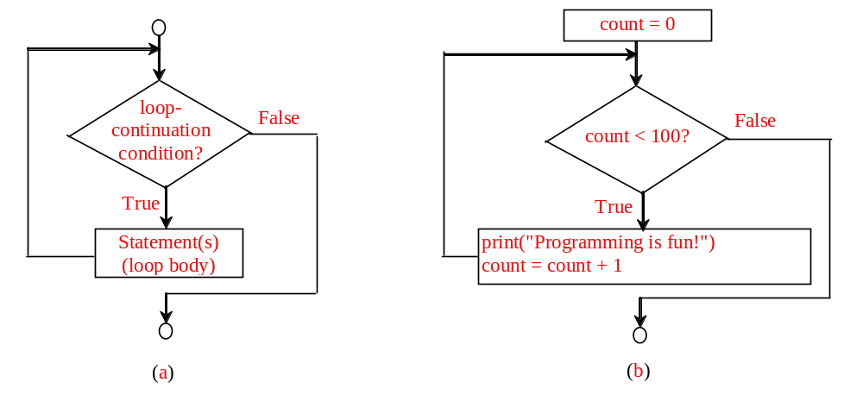
while Loop Flow Chart
count = 0
while count < 100:
print("Programming is fun!")
count = count + 1
while loop-continuation-condition:
# Loop body
Statement(s)

Slide 7
Trace while Loop
animation
Initialize count
count = 0
while count < 2:
print("Programming is fun!")
count = count + 1

Slide 8
Trace while Loop, cont.
animation
(count < 2) is true
count = 0
while count < 2:
print("Programming is fun!")
count = count + 1

Slide 9
Trace while Loop, cont.
animation
Print Welcome to Python
count = 0
while count < 2:
print("Programming is fun!")
count = count + 1

Slide 10
Trace while Loop, cont.
animation
Increase count by 1
count is 1 now
count = 0
while count < 2:
print("Programming is fun!")
count = count + 1

Slide 11
Trace while Loop, cont.
animation
(count < 2) is still true since count is 1
count = 0
while count < 2:
print("Programming is fun!")
count = count + 1

Slide 12
Trace while Loop, cont.
animation
Print Welcome to Python
count = 0
while count < 2:
print("Programming is fun!")
count = count + 1

Slide 13
Trace while Loop, cont.
animation
Increase count by 1
count is 2 now
count = 0
while count < 2:
print("Programming is fun!")
count = count + 1

Slide 14
Trace while Loop, cont.
animation
(count < 2) is false since count is 2 now
count = 0
while count < 2:
print("Programming is fun!")
count = count + 1

Slide 15
Trace while Loop
animation
The loop exits. Execute the next statement after the loop.
count = 0
while count < 2:
print("Programming is fun!")
count = count + 1

Slide 16

Problem: An Advanced Math Learning Tool
The Math subtraction learning tool program generates just one question for each run. You can use a loop to generate questions repeatedly. This example gives a program that generates five questions and reports the number of the correct answers after a student answers all five questions.
SubtractionQuizLoop

Slide 17
Problem: Guessing Numbers
Write a program that randomly generates an integer between 0 and 100, inclusive. The program prompts the user to enter a number continuously until the number matches the randomly generated number. For each user input, the program tells the user whether the input is too low or too high, so the user can choose the next input intelligently. Here is a sample run:
GuessNumberOneTime
GuessNumber

Slide 18
Ending a Loop with a Sentinel Value
Often the number of times a loop is executed is not predetermined. You may use an input value to signify the end of the loop. Such a value is known as a sentinel value.
Write a program that reads and calculates the sum of an unspecified number of integers. The input 0 signifies the end of the input.
SentinelValue

Slide 19
Caution
Don’t use floating-point values for equality checking in a loop control. Since floating-point values are approximations for some values, using them could result in imprecise counter values and inaccurate results. Consider the following code for computing 1 + 0.9 + 0.8 + ... + 0.1:
item = 1
sum = 0
while item != 0: # No guarantee item will be 0
sum += item
item -= 0.1
print(sum)
Variable item starts with 1 and is reduced by 0.1 every time the loop body is executed. The loop should terminate when item becomes 0. However, there is no guarantee that item will be exactly 0, because the floating-point arithmetic is approximated. This loop seems OK on the surface, but it is actually an infinite loop.

Slide 20
for Loops
i = initialValue # Initialize loop-control variable
while i < endValue:
# Loop body
...
i++ # Adjust loop-control variable
for i in range(initialValue, endValue):
# Loop body

Slide 21
range(a, b)
>>> for v in range(4, 8):
... print(v)
...
4
5
6
7
>>>

Slide 22
range(b)
>>> for i in range(4):
... print(i)
...
0
1
2
3
>>>

Slide 23
range(a, b, step)
>>> for v in range(3, 9, 2):
... print(v)
...
3
5
7
>>>

Slide 24
range(a, b, step)
>>> for v in range(5, 1, -1):
... print(v)
...
5
4
3
2
>>>

Slide 25
Nested Loops
Problem: Write a program that uses nested for loops to print a multiplication table.
MultiplicationTable

Slide 26
Minimizing Numerical Errors
Numeric errors involving floating-point numbers are inevitable. This section discusses how to minimize such errors through an example.
Here is an example that sums a series that starts with 0.01 and ends with 1.0. The numbers in the series will increment by 0.01, as follows: 0.01 + 0.02 + 0.03 and so on.
TestSum

Slide 27
Problem:
Finding the Greatest Common Divisor
Problem: Write a program that prompts the user to enter two positive integers and finds their greatest common divisor.
Solution: Suppose you enter two integers 4 and 2, their greatest common divisor is 2. Suppose you enter two integers 16 and 24, their greatest common divisor is 8. So, how do you find the greatest common divisor? Let the two input integers be n1 and n2. You know number 1 is a common divisor, but it may not be the greatest commons divisor. So you can check whether k (for k = 2, 3, 4, and so on) is a common divisor for n1 and n2, until k is greater than n1 or n2.
GreatestCommonDivisor
Run

Slide 28
Problem: Predicting the Future Tuition
Problem: Suppose that the tuition for a university is $10,000 this year and tuition increases 7% every year. In how many years will the tuition be doubled?
FutureTuition
Run

Slide 29
Problem: Predicating the Future Tuition
year = 0 # Year 0
tuition = 10000
year += 1 # Year 1
tuition = tuition * 1.07
year += 1 # Year 2
tuition = tuition * 1.07
year += 1 # Year 3
tuition = tuition * 1.07
FutureTuition
Run

Slide 30

Problem: Monte Carlo Simulation
The Monte Carlo simulation refers to a technique that uses random numbers and probability to solve problems. This method has a wide range of applications in computational mathematics, physics, chemistry, and finance. This section gives an example of using the Monto Carlo simulation for estimating π.
circleArea / squareArea = π / 4.
π can be approximated as 4 * numberOfHits / 1000000.
MonteCarloSimulation
Run

Slide 31
Using break and continue
Examples for using the break and continue keywords:
TestBreak.py
TestBreak
TestContinue.py
TestContinue

Slide 32
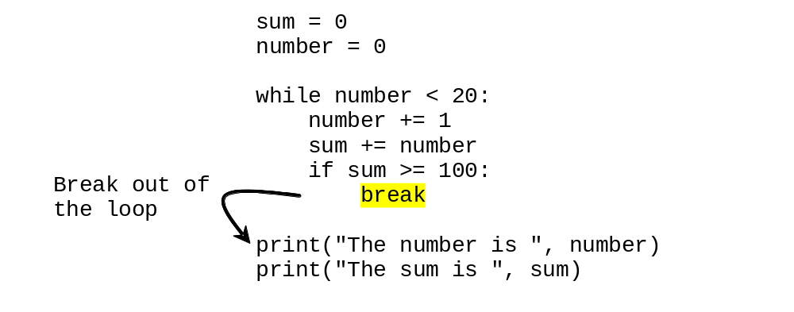
break

Slide 33
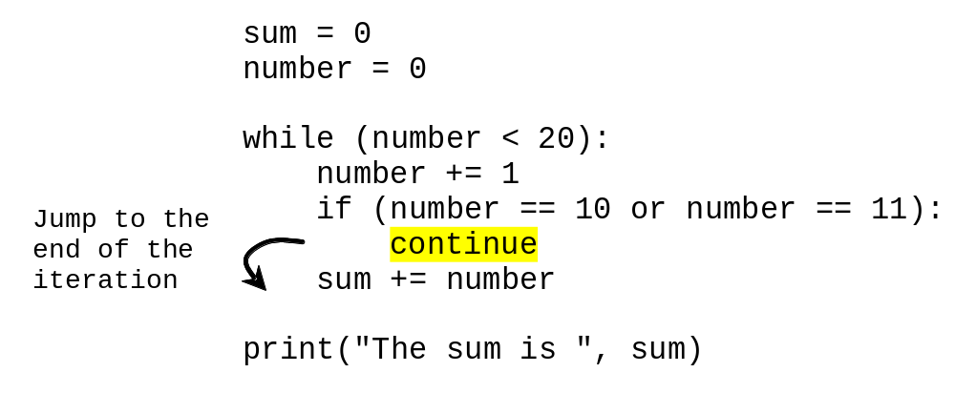
continue

Slide 34
Guessing Number Problem Revisited
Here is a program for guessing a number. You can rewrite it using a break statement.
GuessNumberUsingBreak

Slide 35
Problem: Displaying Prime Numbers
Problem: Write a program that displays the first 50 prime numbers in five lines, each of which contains 10 numbers. An integer greater than 1 is prime if its only positive divisor is 1 or itself. For example, 2, 3, 5, and 7 are prime numbers, but 4, 6, 8, and 9 are not.
Solution: The problem can be broken into the following tasks:
  For number = 2, 3, 4, 5, 6, ..., test whether the number is prime.
  Determine whether a given number is prime.
  Count the prime numbers.
  Print each prime number, and print 10 numbers per line.
PrimeNumber
Run

Slide 36
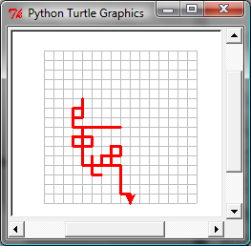
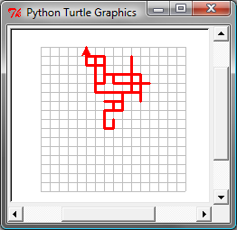
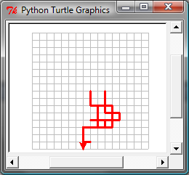
Turtle: Random Walk
RandomWalk
Run

